Slide 1
Fecal Sludge Management in South and South East Asia: Needs and Interventions
Thammarat Koottatep

Slide 2
Hurry up in the toilet: 4.3 Billion are waiting
Source: http://www.takepart.com/

Slide 3
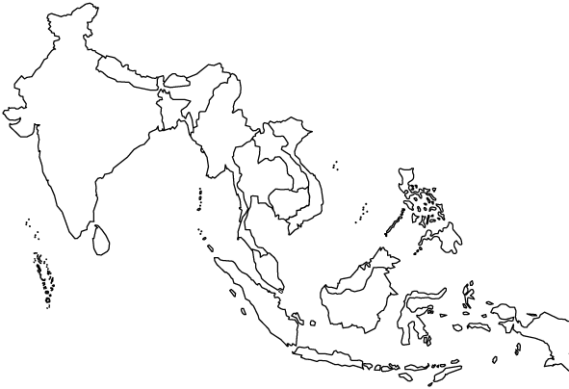
Toilet Market in South and Southeast Asia
No. of Household (Millions)
Nepal
0.70 | 0.16
India
Thailand
3.25 | 0.33
72.00 | 22.32
Cambodia
0.43 | 0.09
Bangladesh
7.90 | 2.92
Philippines
11.05 | 2.43
Vietnam
4.75 | 0.48
Indonesia
21.70 | 3.91
Urban household
Urban poor household
Sources:
-Information on Bangladesh, Cambodia, India, Indonesia, Nepal, Philippines, and Sri Lanka are from Urban Profiles (2002), published by the US Agency for International Development (USAID).
-Other country data are from the UN Centre for Human Settlements (Habitat), the World Bank, and the UNDP Human Development Index.
-Aprodicio A. Laquian., Who are the Poor and How Are They Being Served in Asian Cities?. University of British Columbia, Vancouver, Canada
-UNHCR - The UN Refugee Agency, 2014

Slide 4
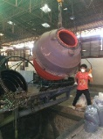
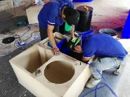
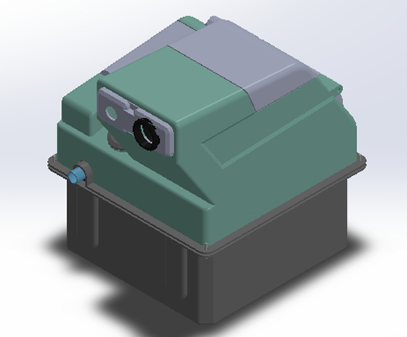
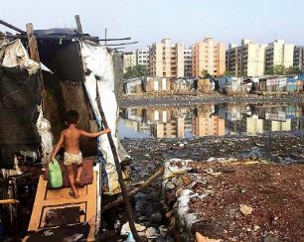
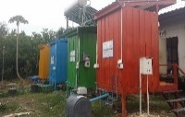
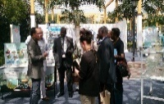
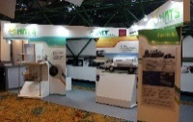
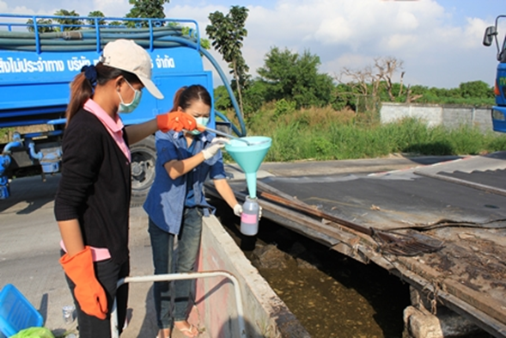
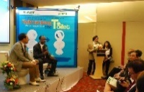
Technology Evolution
AIT Reinvented Toilets
2013: Idea Screening
2014: Concept Development & Testing
2015: Product Development
2016: Business Analysis
2017: Commercialization
2012: Idea Generation

Slide 5
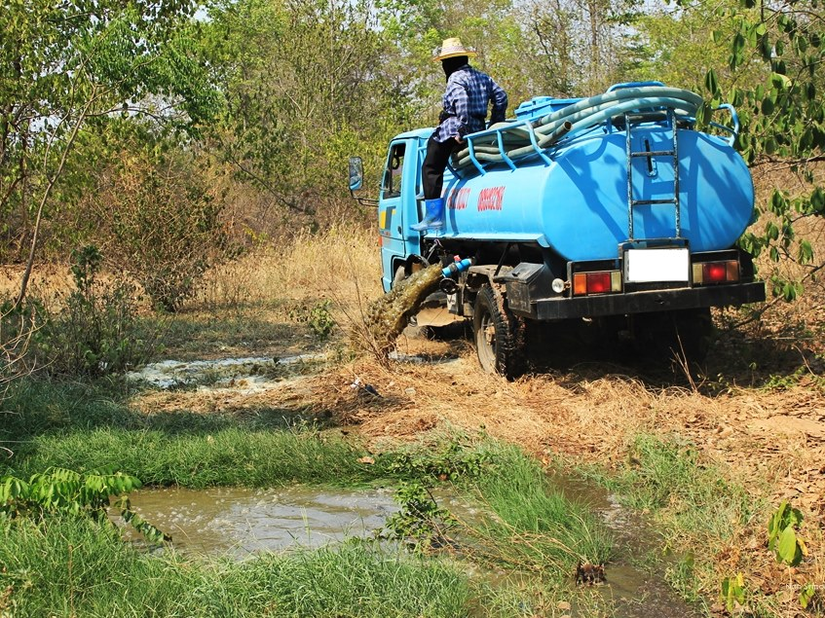
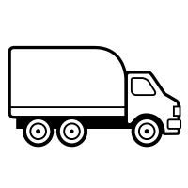
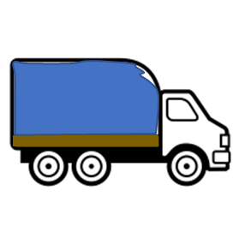
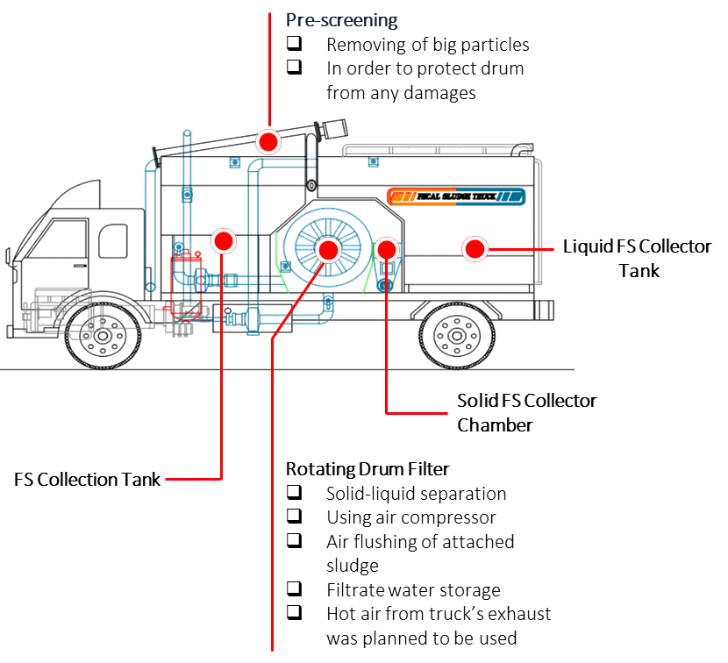
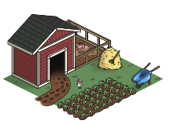
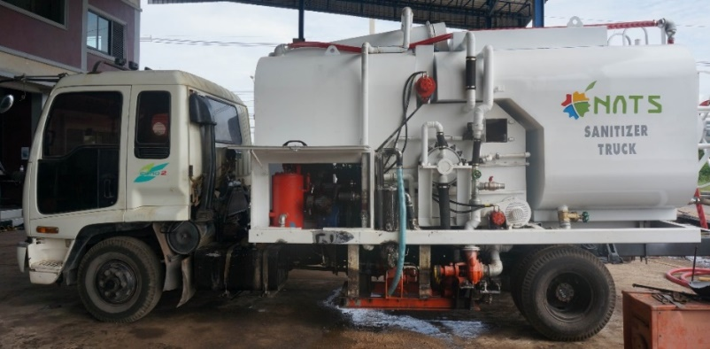
Sanitizer Truck
98%
water
Conventional
Truck
Households
Conventional
Truck
FS treatment plant
Idea
Sanitizer truck
(More) Households
Solid-Liquid
separation
Solids
Liquid
(Smaller)
FS treatment plant
Target: …%
Benefits
Disinfection
Sewer system
Agricultural area

Slide 6
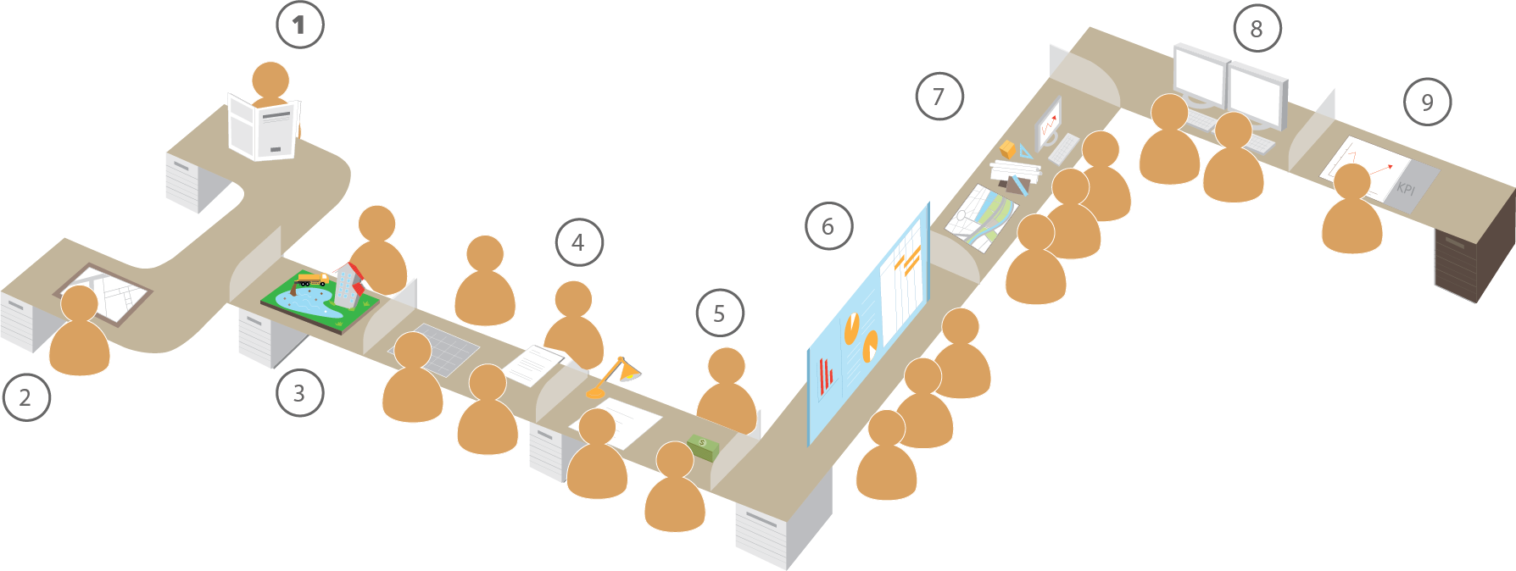
FSM TOOLBOX
Comprehensive collection + Development and Dissemination
of tools on FSM to enhance the capability of the key players to work towards effective & sustainable implementation (planning) of FSM
Exploratory Study
Operation &
Maintenance
Monitoring
Review & Correct
Implementing
the Strategy
Strategy Design
Options
Appraisal &
Approval
Advocacy
Capacity Building
Country Strategy
Programming
Defining the Need &
Scope of Strategies
FSM Media
step-by-step guide with “tailor-made solutions”
Workflow to carry out FSM related activities

Slide 7
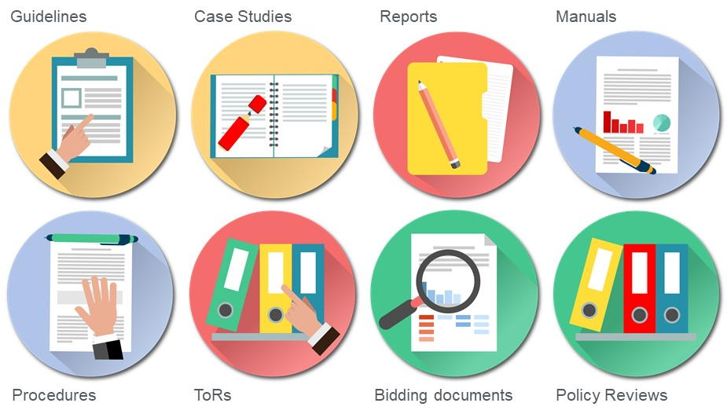
Situational Assessment Tool
IFSM Citywide Assessment and Planning Toolkit
17
Financial & Technical Assessment Tool
SANIPLAN
Regulatory & Institutional Assessment Tool
SaniTab
PSP
Stakeholder Analysis Tool
Job Profile Matrix
Key Performance Indicator Tool
SANITECH
Planning Tool
tools
Advocacy Manual
Planning Tool
Logistic Tool
Shit Flow Diagram
Monitoring Tool
Developed after careful consideration on what is in demand
Easy to use
Built on platforms that are familiar to the users
Simple data entry
Easy to interpret results
Helps users in the thought-process of “what next”
200+
Non-tool
resources

Slide 8
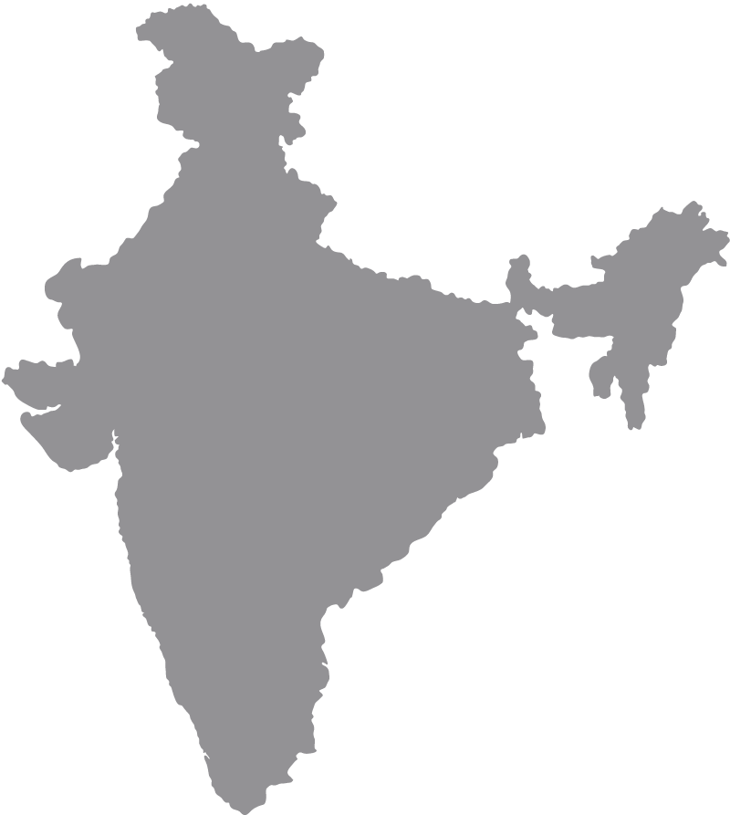
Application and Contextualization
of Toolbox
Bangladesh
Myanmar
African context
India
Laos
Uganda
Indonesia
Indian context

Slide 9
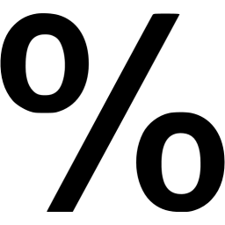
CASE STUDY: Mingalar Taung Nyunt Township, Myanmar
Situational Assessment Tool
Containment Systems
Mingalar Taung Nyunt is a township which, is spread across an area of 25 km² in Yangon, Myanmar.
Total population of 131, 563
95% population have OSS
Emptying
Treatment
Reuse
Transportation
Accessibility:100%
Emptying Frequency : Regular
Treatment Plant: Exists
Capacity: Adequate at present
Market Potential: Exist for treated effluent for non-food crops
Further, need to study potential for bio-solids
Adequacy of vehicles: Adequate
Condition of vehicles: Good with regular maintenance
74%
57%
Capacity
Institutional
64%
49%
Awareness
Regulatory
62%
Infrastructure
84%
Financial & Management

Slide 10
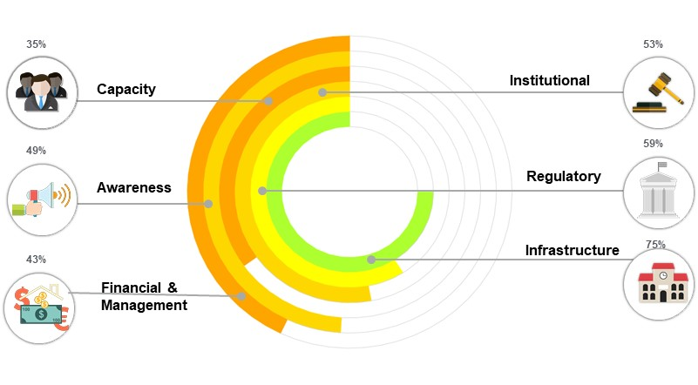
CASE STUDY: Khulna, Bangladesh
Situational Assessment Tool
Containment Systems
Khulna, an urban city in the south western Bangladesh, is spread across an area of 46 km²
Total population of 1,500, 000
99% population have OSS
High groundwater table and accounts for 50 % of the water supply
Emptying
Treatment
Reuse
Transportation
Accessibility:100% Emptying Frequency : Regular, Most of them are emptied to drains and open land
Treatment Plant: Exists
Capacity: Adequate at present
Market Potential: Socio-cultural barrier restricts the use of treated FS
Adequacy of vehicles: Limited
Condition of vehicles: Good, needs regular maintenance

Slide 11
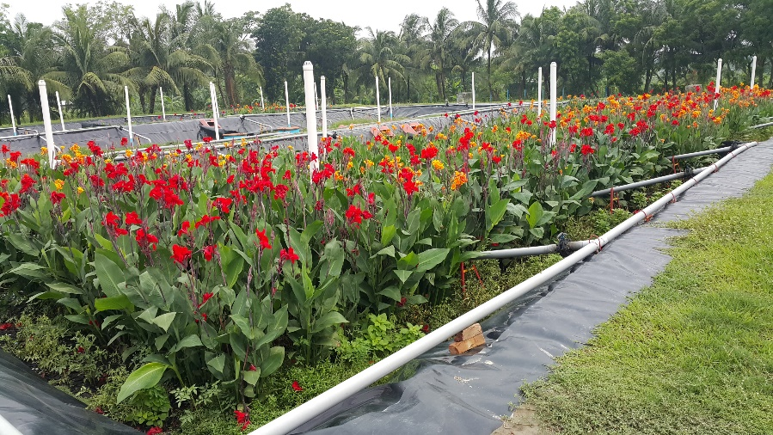
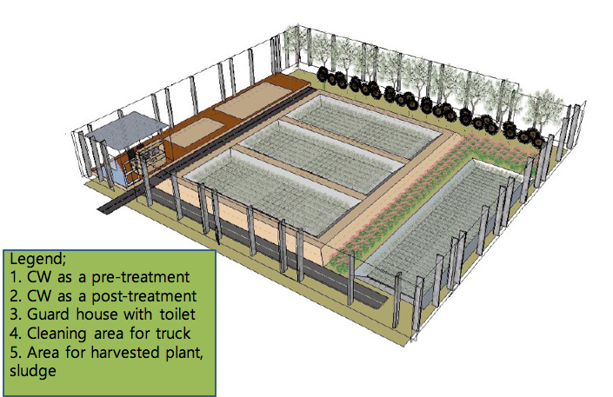
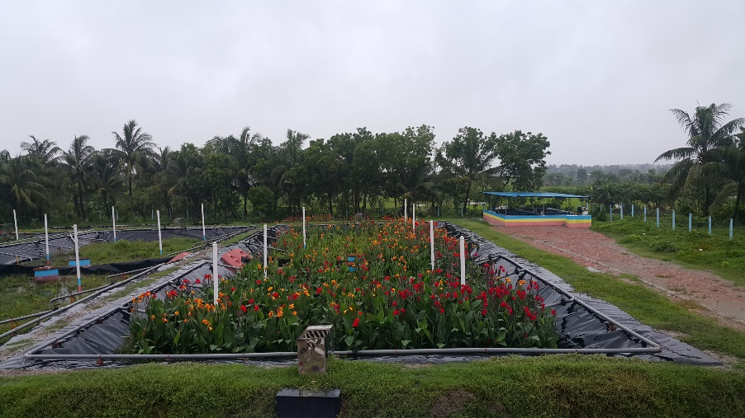
Faecal Sludge Treatment Plant for Khulna City
Design
Systems: Vertical-flow Constructed Wetlands
Treatment capacity: 180 m³/day
Capital costs: 150,000 USD (excluding building and land)

Slide 12
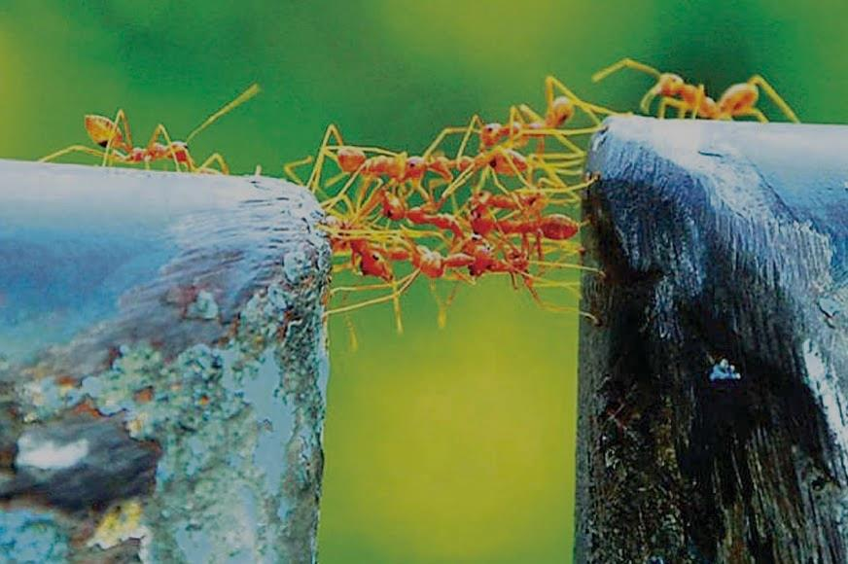
We create a bridge for sanitation innovations
Thank You

